Slide 1


Prasanna Ramamoorthy
21Aug2022

Slide 2

Outline
Executive Summary
Introduction
Methodology
Results
Conclusion
Appendix

Slide 3
Executive Summary
Summary of methodologies
In this exercise, methodologies like Data Collection, Data Wrangling, Exploratory Analysis with SQL Exploratory Analysis with Python & Matplotlib, Data Visualization were covered and the given dataset was analyzed using the above methodologies and a prediction model was developed to predict the success of first stage of Falcon 9 landing.
Summary of all results
With the given dataset and the predictive analysis was carried out to predict the success of first stage of Falcon 9 landing. Different prediction algorithms like Logistic Regression, Support Vector Machine, Decision Tree & KNN were used in the predictive analysis. To summarize the results, the predictive analysis states that the success rate is more than 75%.

Slide 4
Introduction
Project background and context
We will be gathering information about Space X and creating dashboards and also determine if SpaceX will reuse the first stage. Instead of using rocket science to determine if the first stage will land successfully, we will train a machine learning model and use public information to predict if SpaceX will reuse the first stage.
Problems you want to find answers
Determine the price of each launch
If first stage of Falcon 9 will land successfully?
Will SpaceX will reuse the first stage?

Slide 5

Section 1

Slide 6
Methodology
Executive Summary
Data collection methodology:
Data was collected using API & Web scrapping. The dataset was collected using the SpaceX REST API. Data was collected from the SpaceX REST API endpoints and the collected data was in JSON format which was then parsed and used as DataFrames later. The data about Falcon 9 in websites was collected using web scrapping which parsed the HTML table data in the web pages and then converted them to DataFrames for further analysis.
Perform data wrangling
The data collected from both the sources were pre-processed using various techniques like collecting more data, filtering/sampling, dealing with null or no data and so on.
Perform exploratory data analysis (EDA) using visualization and SQL
Perform interactive visual analytics using Folium and Plotly Dash
Perform predictive analysis using classification models
How to build, tune, evaluate classification models

Slide 7
Methodology
Executive Summary
Perform exploratory data analysis (EDA) using visualization and SQL
The EDA using SQL is the first step in this data science exercise. The data is first analyzed using basic SQL to analyze the data and see if it can be directly used for machine learning analysis. In this basic EDA using visualization, the main attributes that might be correlating can be identified.
Perform interactive visual analytics using Folium and Plotly Dash
Interactive visual analytics enables users to explore and manipulate data in an interactive and real-way. Common interactions including zoom-in and zoom-out, pan, filter, search, and link. With interactive visual analytics, users could find visual patterns faster and more effectively. The python plotly dashboard application contains input components such as a dropdown list and a range slider to interact with a pie chart and a scatter point chart.
Perform predictive analysis using classification models
The predictive analysis includes Preprocessing, allowing us to standardize our data, and Train_test_split, allowing us to split our data into training and testing data, Once the data is split, we will train the model and perform Grid Search, allowing us to find the hyperparameters that allow a given algorithm to perform best. Using the best hyperparameter values, we will determine the model with the best accuracy using the training data

Slide 8
Data Collection
Describe how data sets were collected.
The data is collected using the both the below methods
SpaceX Rest API
Web Scrapping of SpaceX Web Page containing the data

Slide 9
Data Collection – SpaceX API
Python Request
GET (URL)
import requests
spacex_url="https://api.spacexdata.com/v4/launches/past"
response = requests.get(spacex_url)
response.json()
data = pd.json_normalize(response.json())
SpaceX REST Web API
Json Response
https://github.com/prasanna3ram/datascience/blob/bdf973a12c691c47d02b9651a2577e01f81cc026/Data_Collection_lab1.ipynb
Parse data to Pandas DataFrame

Slide 10
Data Collection - Scraping
Beautiful Soup library
Scrapping web page
import requests
from bs4 import BeautifulSoup
static_url = "https://en.wikipedia.org/w/index.php?title=List_of_Falcon_9_and_Falcon_Heavy_launches&oldid=1027686922"
response = requests.get(static_url)
soup = BeautifulSoup(response.text, 'html.parser')
SpaceX Webpage containing data
Data in HTML tables format
https://github.com/prasanna3ram/datascience/blob/bdf973a12c691c47d02b9651a2577e01f81cc026/data_extraction_scrapping.ipynb
Parse HTML tables to Pandas DataFrame

Slide 11
Data Wrangling
Describe how data were processed
Data was processed using to identify the % of missing values, identify the numerical and categorical columns, number of launches in each sites, the number and occurrence of each orbit
You need to present your data wrangling process using key phrases and flowcharts
df.isnull().sum()/df.count()*100
df['LaunchSite'].value_counts()
df["Class"].mean()
DataFrame
.Value_counts
https://github.com/prasanna3ram/datascience/blob/bdf973a12c691c47d02b9651a2577e01f81cc026/Data_wrangling.ipynb
.mean()

Slide 12
EDA with Data Visualization
Summarize what charts were plotted and why you used those charts
In this exercise 3 different types of charts from the seaborn library namely the scatterplot, bar charts and the line charts were used. The scatterplot was used to identify the distribution of success rates among different launch sites.
Add the GitHub URL of your completed EDA with data visualization notebook, as an external reference and peer-review purpose
https://github.com/prasanna3ram/datascience/blob/bdf973a12c691c47d02b9651a2577e01f81cc026/DataVizualization.ipynb

Slide 13
EDA with SQL
Using bullet point format, summarize the SQL queries you performed
Distinct - (%sql Select Distinct "Launch_Site" from SPACEXTBL )
LIKE - (Select * from SPACEXTBL WHERE "Launch_Site" LIKE 'CCA%' LIMIT 5)
SUM - (Select SUM("PAYLOAD_MASS__KG_") from SPACEXTBL WHERE "Customer" = 'NASA (CRS)')
AVG -Select AVG("PAYLOAD_MASS__KG_") from SPACEXTBL WHERE "Booster_Version" = 'F9 v1.1'
Min - Select min(Date) from SPACEXTBL Where [Landing _Outcome] = 'Success (ground pad)'
Count & Order by - Select "Mission_Outcome", COUNT(*) from SPACEXTBL GROUP BY "Mission_Outcome"
Subquery - %sql Select "Booster_Version", "PAYLOAD_MASS__KG_"from SPACEXTBL Where "PAYLOAD_MASS__KG_" = (Select Max("PAYLOAD_MASS__KG_") as mp from SPACEXTBL)

Slide 14
EDA with SQL
Substr - %sql Select substr(Date, 4, 2),[Landing _Outcome],"Booster_Version", "Launch_Site" from SPACEXTBL Where [Landing _Outcome] like '%Failure (drone ship)%' and substr("Date",7,4)= '2015'
Rank - %sql Select *, Rank() OVER(order by [Landing _Outcome])rank from SPACEXTBL where [Landing _Outcome] like '%Success%' and substr(Date,7)||substr(Date,4,2)||substr(Date,1,2) between '20100604' and '20170320'Order By rank DESC
https://github.com/prasanna3ram/datascience/blob/bdf973a12c691c47d02b9651a2577e01f81cc026/sql.ipynb

Slide 15
Build an Interactive Map with Folium
Summarize what map objects such as markers, circles, lines, etc. you created and added to a folium map
Objects like markers, circles & lines were used in the folium map created to identify the specific location for which the coordinates were available
Explain why you added those objects
The marker object was used to identify the specific location, provide labels to the marked points and identify them with different symbols
The circle object was used to highlight the specific location in the map with a circle of specified radius
The line object was used to represent the distance betweem two locations, identify the gap,direction between the location points
https://github.com/prasanna3ram/datascience/blob/ae5026dabb6ba81bf2a8c1a1802fb8c3f8f3ecc6/lab_jupyter_launch_site_location%20(1).ipynb

Slide 16
Build a Dashboard with Plotly Dash
Summarize what plots/graphs and interactions you have added to a dashboard
Added a Launch Site Drop-down Input Component
Added a callback function to render success-pie-chart based on selected site dropdown
Added a Range Slider to Select Payload
Added a callback function to render the success-payload-scatter-chart scatter plot
Explain why you added those plots and interactions
To interact with the data and understand various analytical results from the data through various visualization results that were the results of those plots and interactions added to the dashboards
https://github.com/prasanna3ram/datascience/blob/ed767134129a6a4fa15c77a5d214f2c1e3d21a9d/plotly.ipynb

Slide 17
Predictive Analysis (Classification)
Summarize how you built, evaluated, improved, and found the best performing classification model
The model was built by evaluating various algorithms like logistic regression, support vector machine, decision tree, k-nn
The model was then evaluated with the test dataset and then the accuracy of the model was determined from the evaluation
With the accuracies, a confusion matrix was created and then the best model was identified,
You need present your model development process using key phrases and flowchart
https://github.com/prasanna3ram/datascience/blob/ed767134129a6a4fa15c77a5d214f2c1e3d21a9d/ML_final.ipynb

Slide 18
Predictive Analysis (Classification)
You need present your model development process using key phrases and flowchart
Load data
Standardize data
Split data to test/train pairs
Create object, gridsearch oject
Fit the object to model to find best parameters
Determine accuracy by evaluating the test dataset
Create confusion matrix and evaluate the best performing model

Slide 19
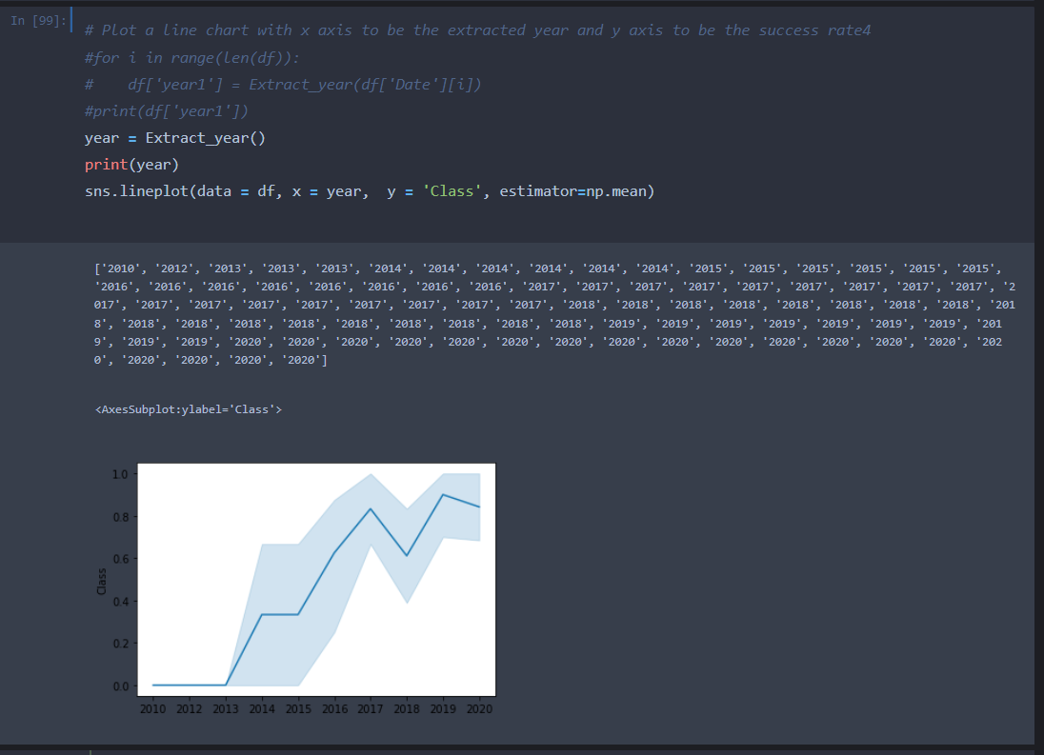
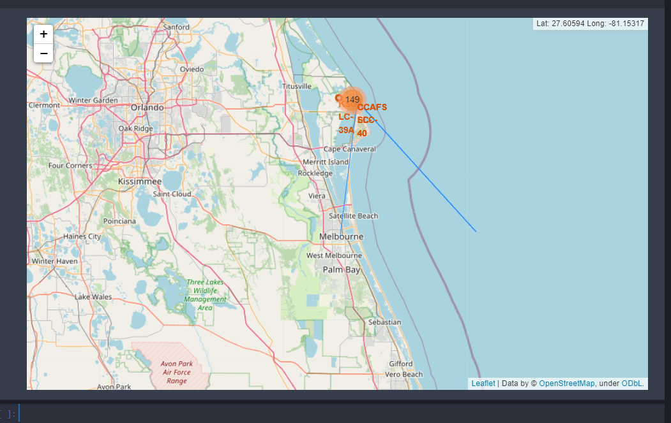
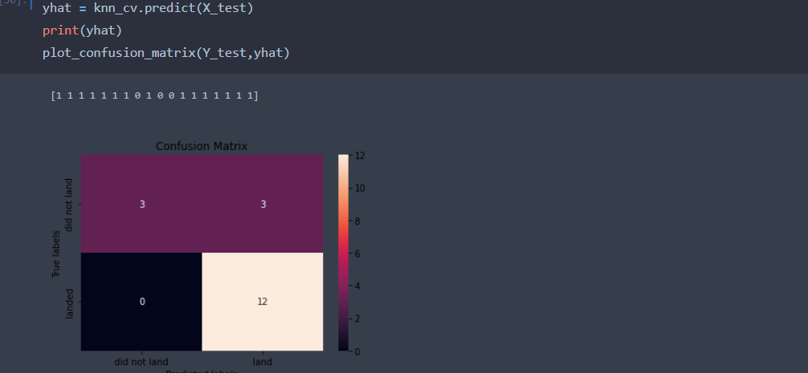
Results
Exploratory data analysis results
Interactive analytics demo in screenshots
Predictive analysis results

Slide 20

Section 2

Slide 21
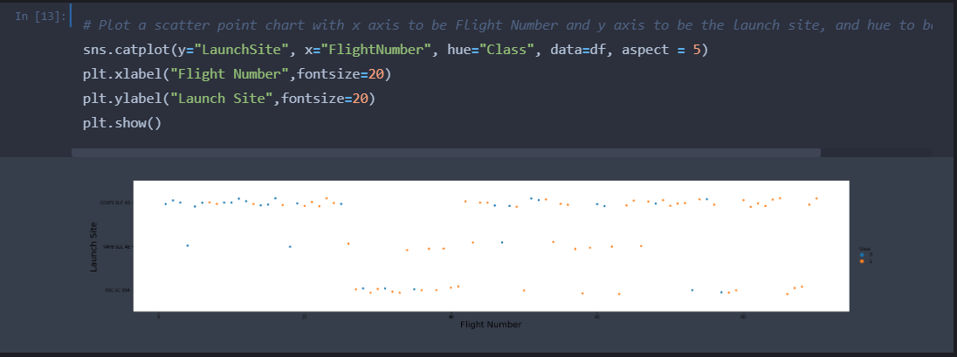
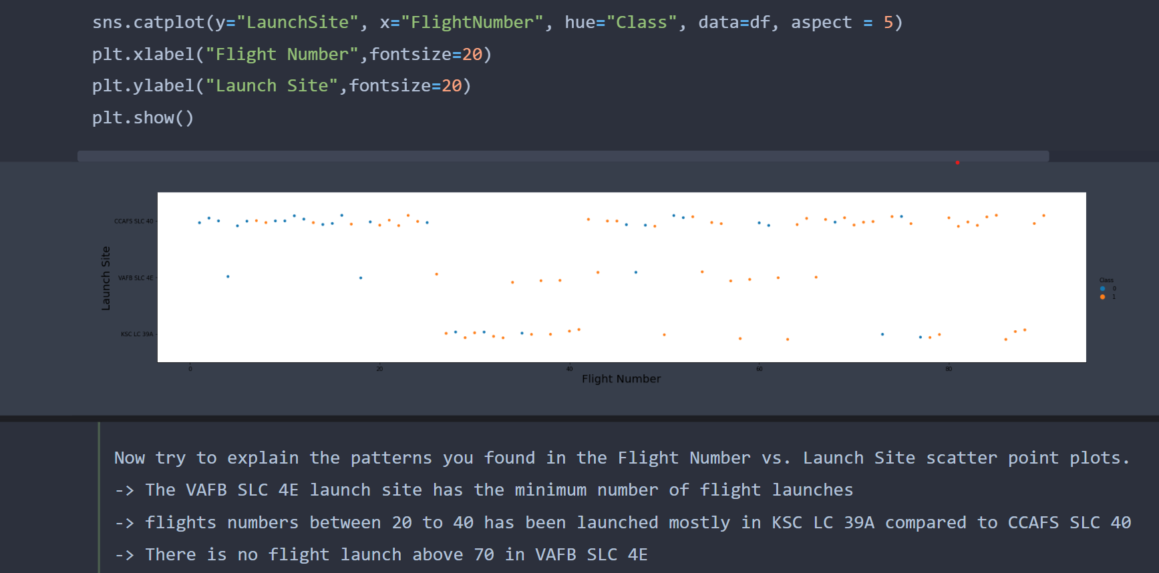
Flight Number vs. Launch Site
Show a scatter plot of Flight Number vs. Launch Site
Show the screenshot of the scatter plot with explanations

Slide 22
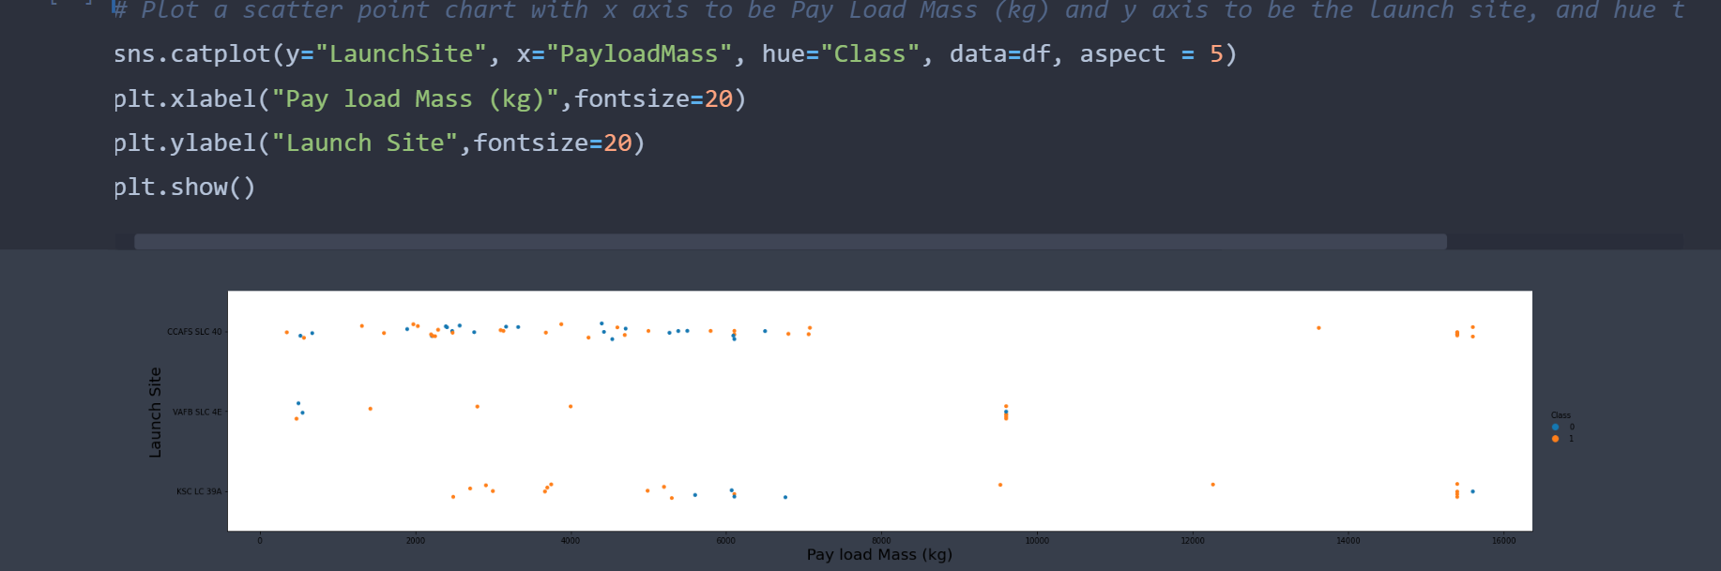
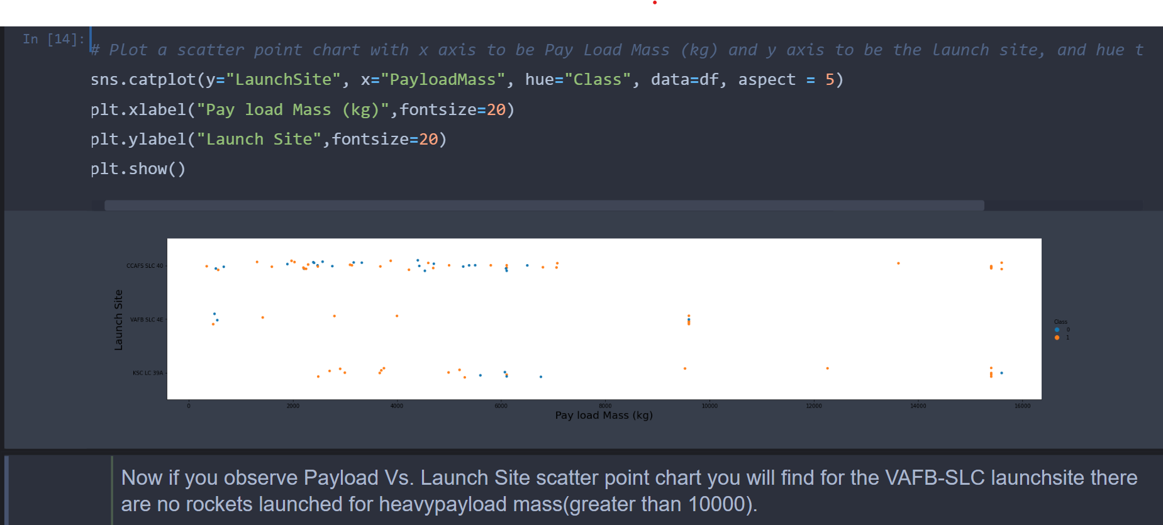
Payload vs. Launch Site
Show a scatter plot of Payload vs. Launch Site
Show the screenshot of the scatter plot with explanations

Slide 23
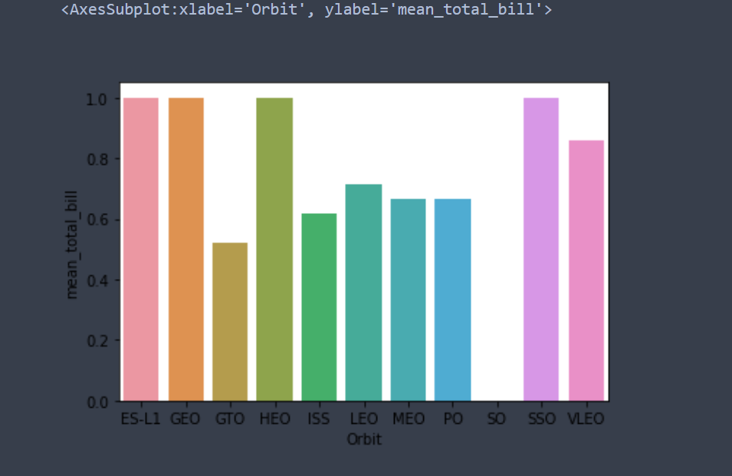
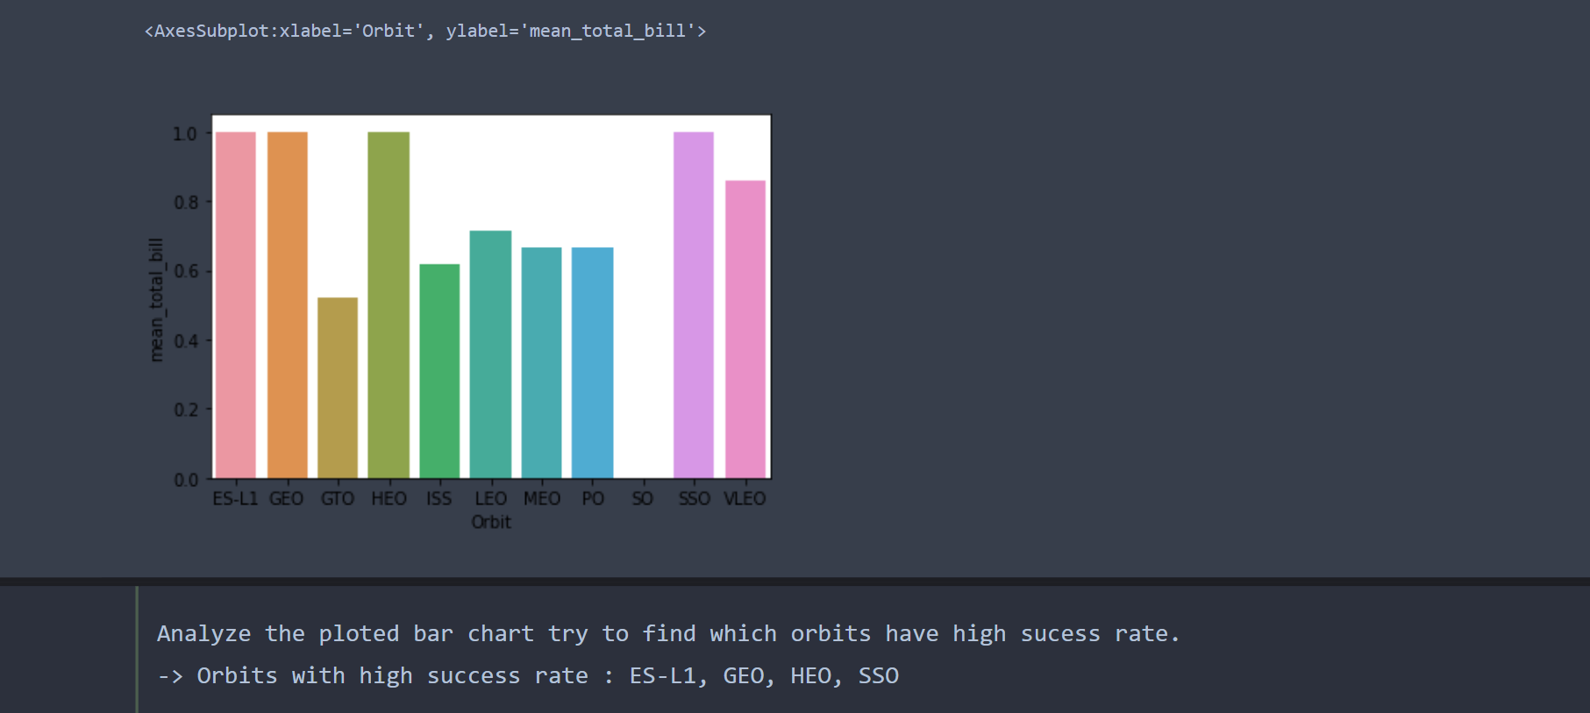
Success Rate vs. Orbit Type
Show a bar chart for the success rate of each orbit type
Show the screenshot of the scatter plot with explanations

Slide 24
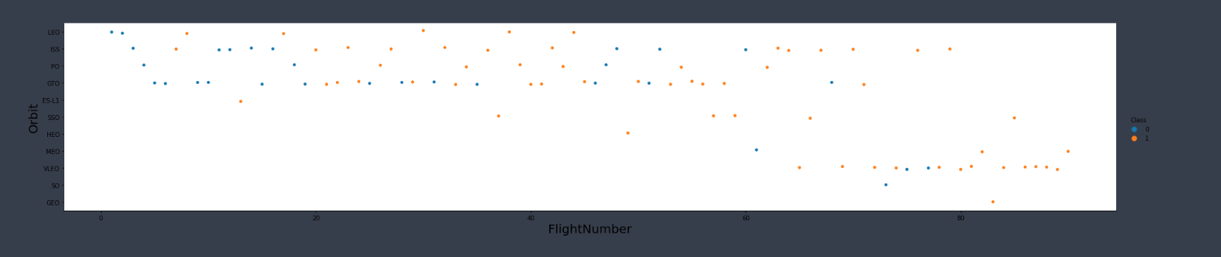
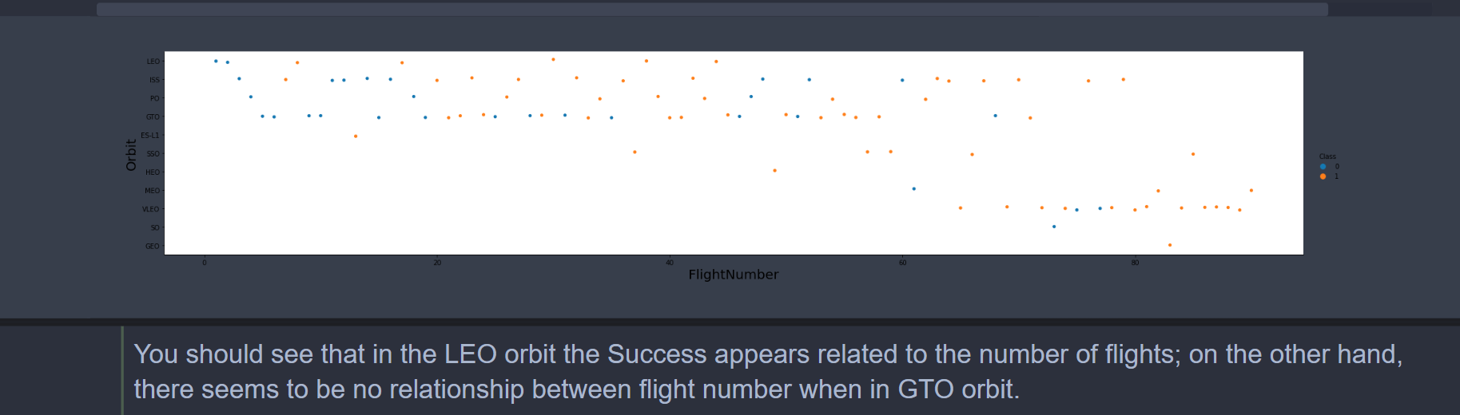
Flight Number vs. Orbit Type
Show a scatter point of Flight number vs. Orbit type
Show the screenshot of the scatter plot with explanations

Slide 25
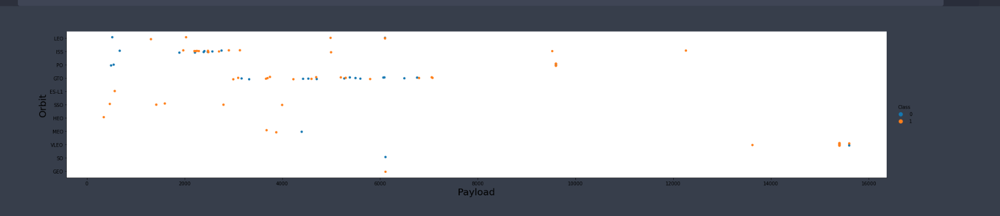
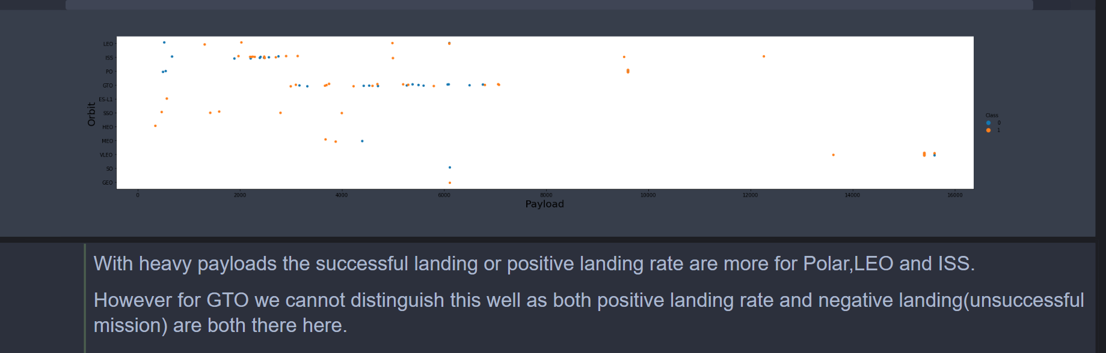
Payload vs. Orbit Type
Show a scatter point of payload vs. orbit type
Show the screenshot of the scatter plot with explanations

Slide 26
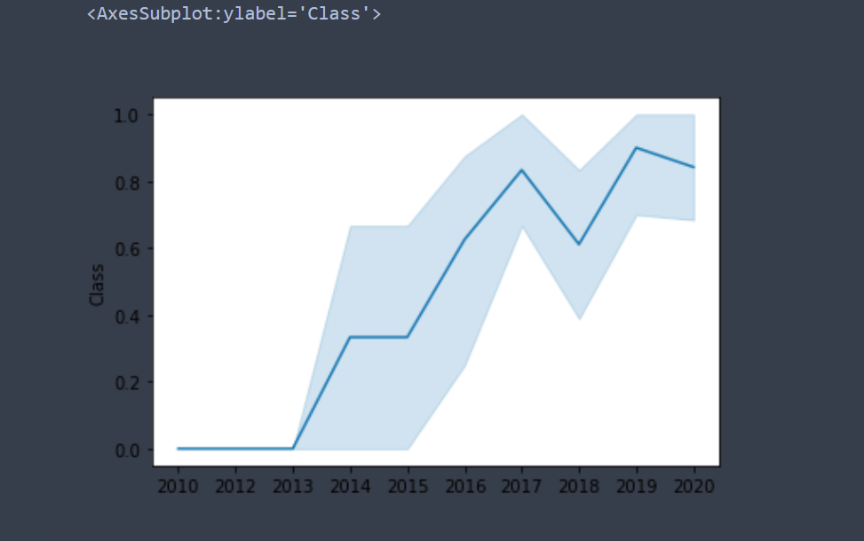
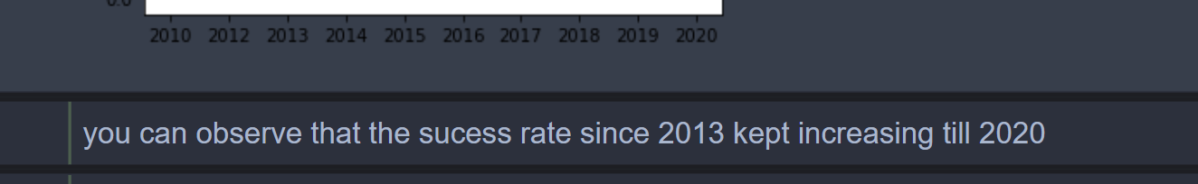
Launch Success Yearly Trend
Show a line chart of yearly average success rate
Show the screenshot of the scatter plot with explanations

Slide 27
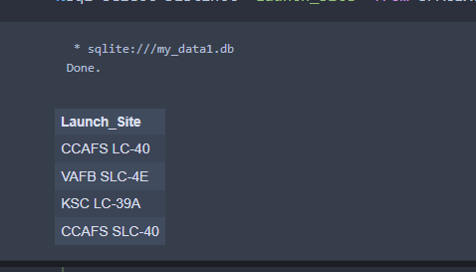
All Launch Site Names
Find the names of the unique launch sites
Present your query result with a short explanation here
There are 4 launch sites : CCAFS LC-40, VAFB SLC-4E, KSC LC-39A, CCAFS SLC-40

Slide 28
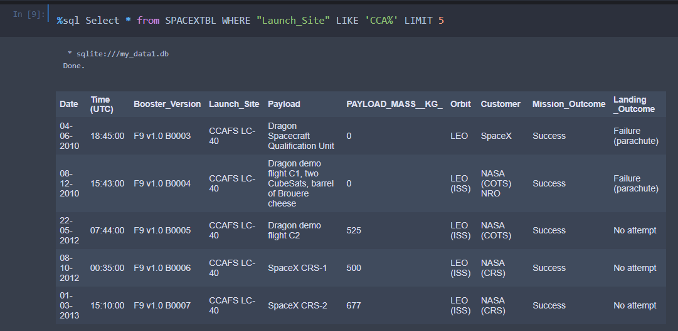
Launch Site Names Begin with 'CCA'
Find 5 records where launch sites begin with `CCA`
Present your query result with a short explanation here
The above query filters the data and brings data with launch sites beginning with "CCA"

Slide 29
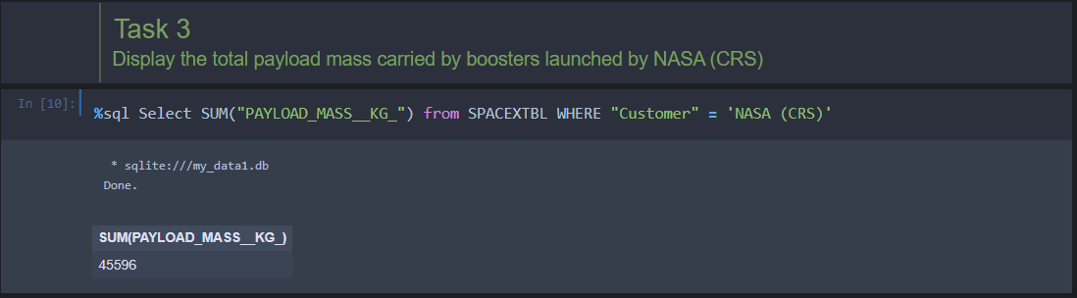
Total Payload Mass
Calculate the total payload carried by boosters from NASA
Present your query result with a short explanation here
The query fetches the payload carried by the boosters from NASA and aggregates them to give the total value

Slide 30
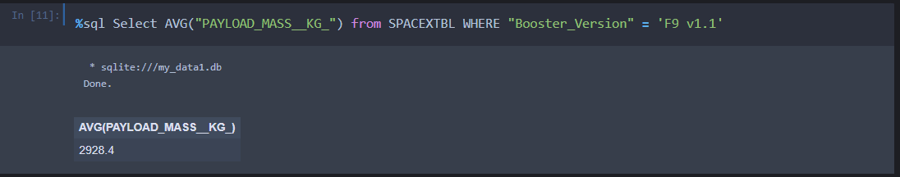
Average Payload Mass by F9 v1.1
Calculate the average payload mass carried by booster version F9 v1.1
Present your query result with a short explanation here

Slide 31
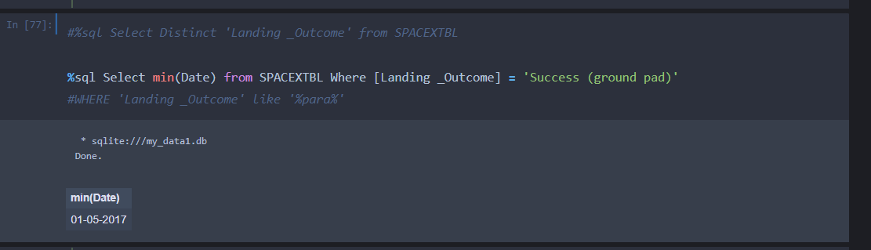
First Successful Ground Landing Date
Find the dates of the first successful landing outcome on ground pad
Present your query result with a short explanation here

Slide 32
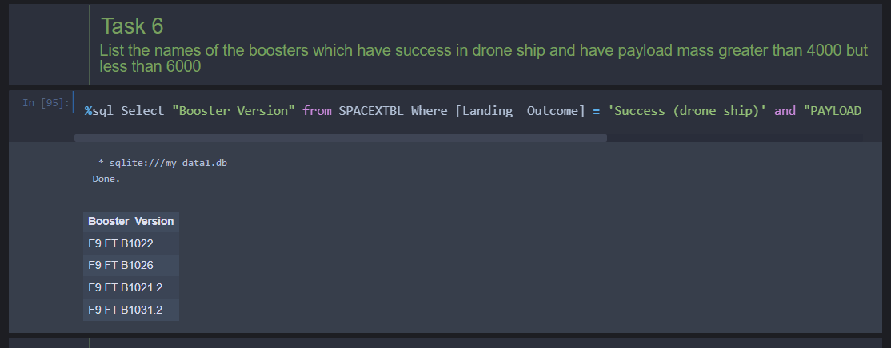
Successful Drone Ship Landing with Payload between 4000 and 6000
List the names of boosters which have successfully landed on drone ship and had payload mass greater than 4000 but less than 6000
Present your query result with a short explanation here

Slide 33
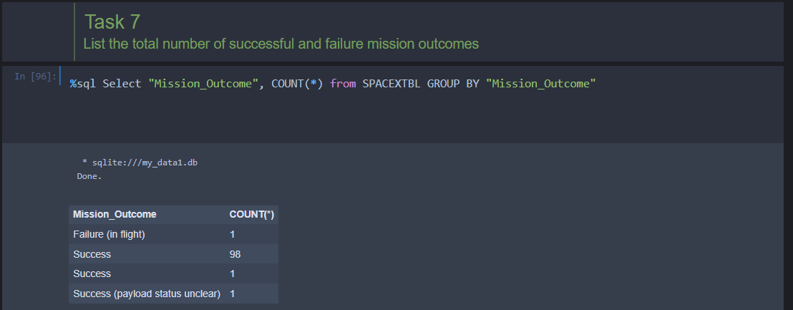
Total Number of Successful and Failure Mission Outcomes
Calculate the total number of successful and failure mission outcomes
Present your query result with a short explanation here

Slide 34
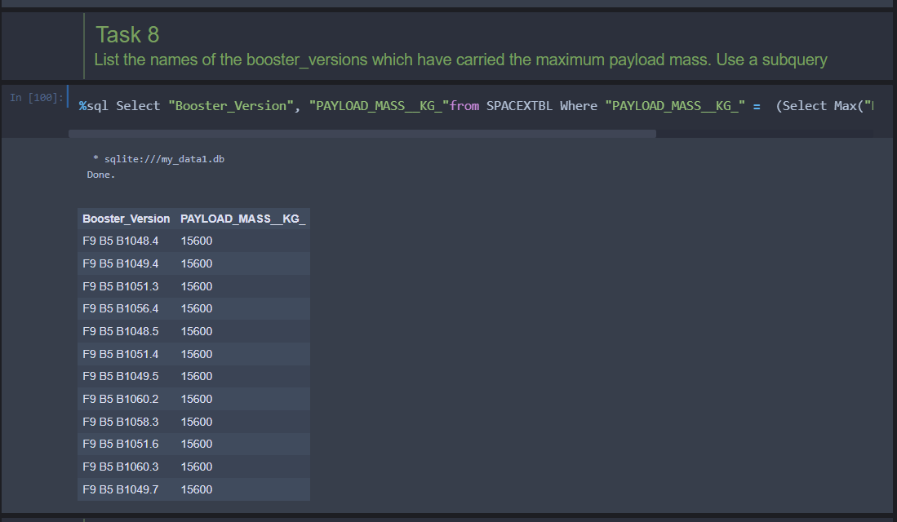
Boosters Carried Maximum Payload
List the names of the booster which have carried the maximum payload mass
Present your query result with a short explanation here

Slide 35
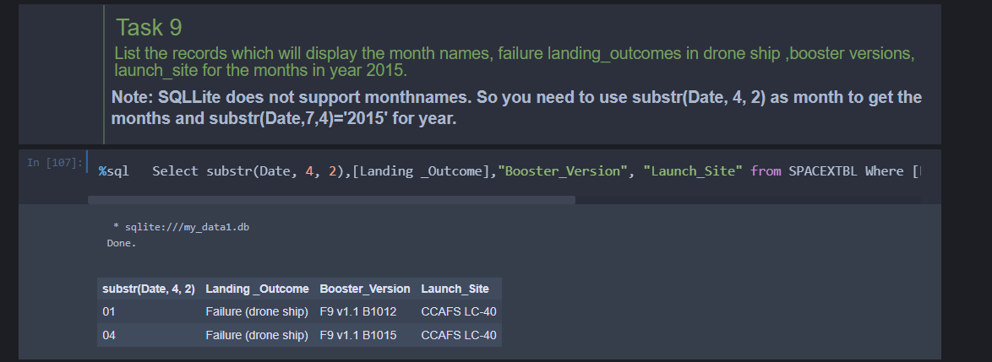
2015 Launch Records
List the failed landing_outcomes in drone ship, their booster versions, and launch site names for in year 2015
Present your query result with a short explanation here

Slide 36
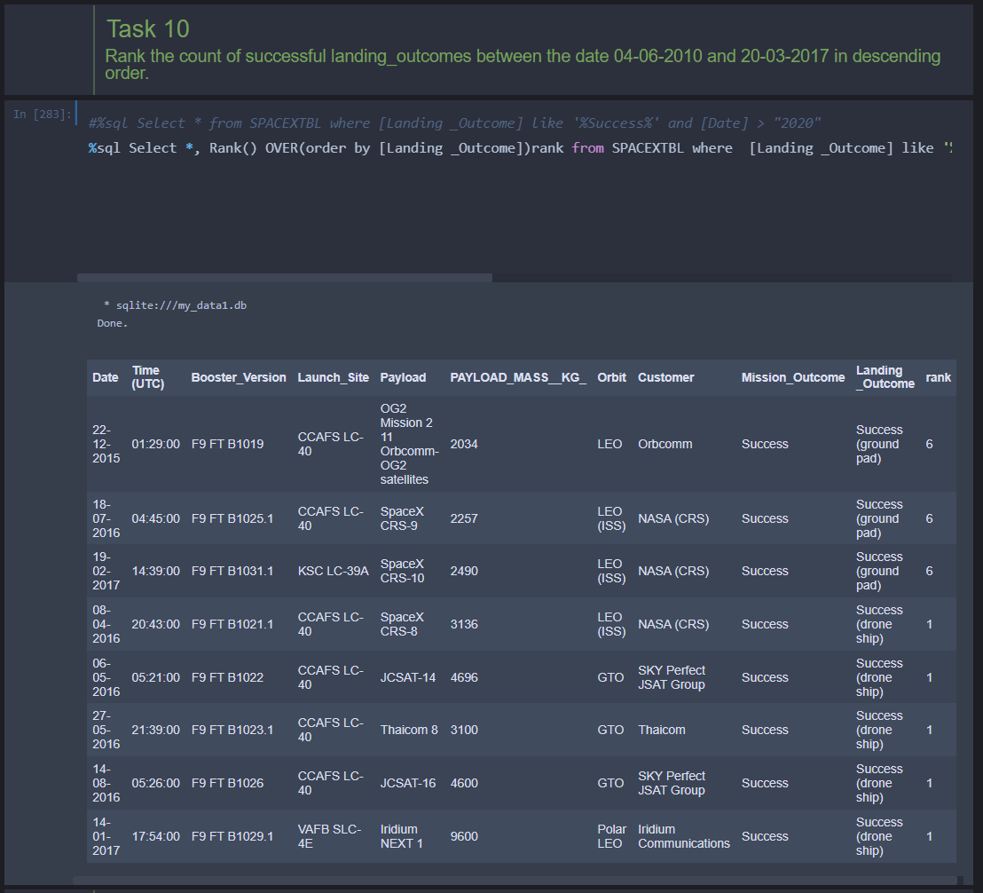
Rank Landing Outcomes Between 2010-06-04 and 2017-03-20
Rank the count of landing outcomes (such as Failure (drone ship) or Success (ground pad)) between the date 2010-06-04 and 2017-03-20, in descending order
Present your query result with a short explanation here

Slide 37

Section 3

Slide 38
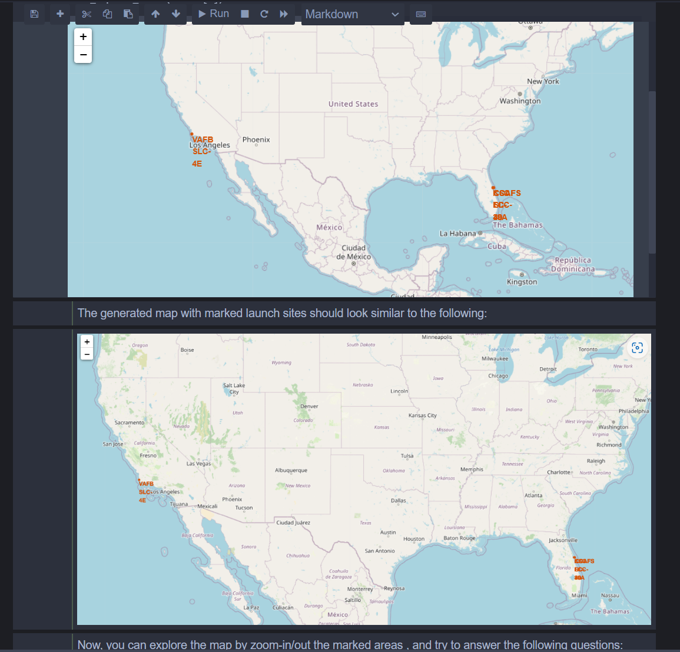
Launch Sites Locations Analysis with Folium
Replace Launch Sites Locations Analysis with Folium title with an appropriate title
Explore the generated folium map and make a proper screenshot to include all launch sites’ location markers on a global map
Explain the important elements and findings on the screenshot
All launch sites in proximity to the Equator line
All launch sites in very close proximity to the coast

Slide 39
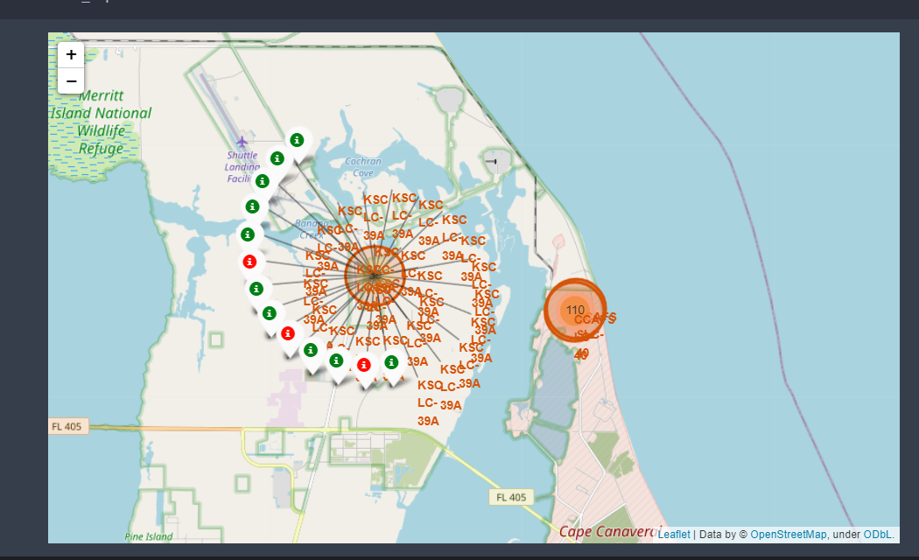
<Folium Map Screenshot 2>
Explore the folium map and make a proper screenshot to show the color-labeled launch outcomes on the map
Explain the important elements and findings on the screenshot
From the screenshot with color markers, it is evident that other than 3 launchpads, rest all launchpads have relatively higher success rate.

Slide 40
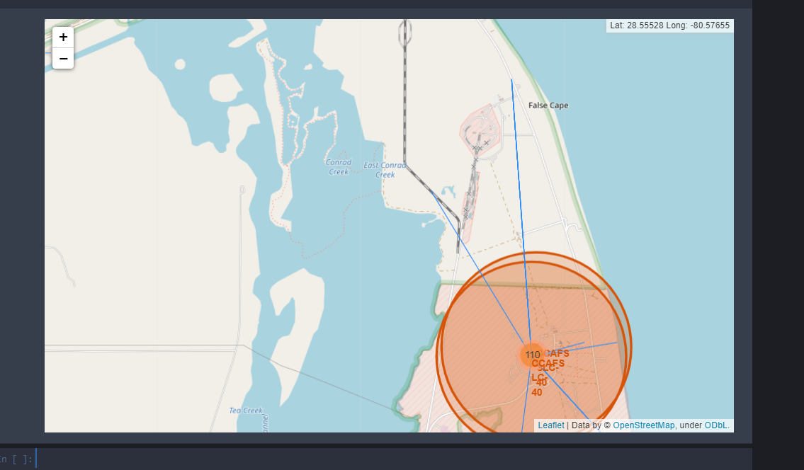
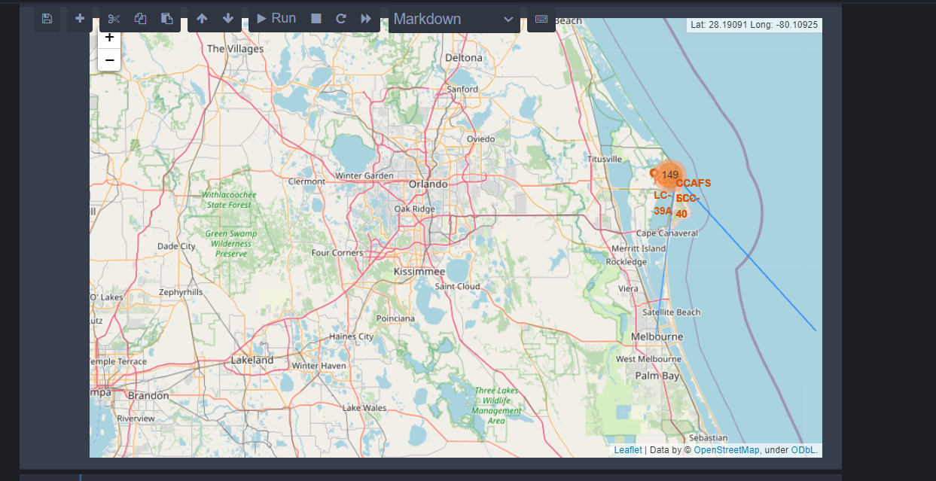
<Folium Map Screenshot 3>
Replace <Folium map screenshot 3> title with an appropriate title
Explore the generated folium map and show the screenshot of a selected launch site to its proximities such as railway, highway, coastline, with distance calculated and displayed
Explain the important elements and findings on the screenshot
Launch site is bit far from railways
Launch site is very far from highways
Launch site is in close proximity to coastline
Launch sites keep certain distance away from cities

Slide 41

Section 4

Slide 42
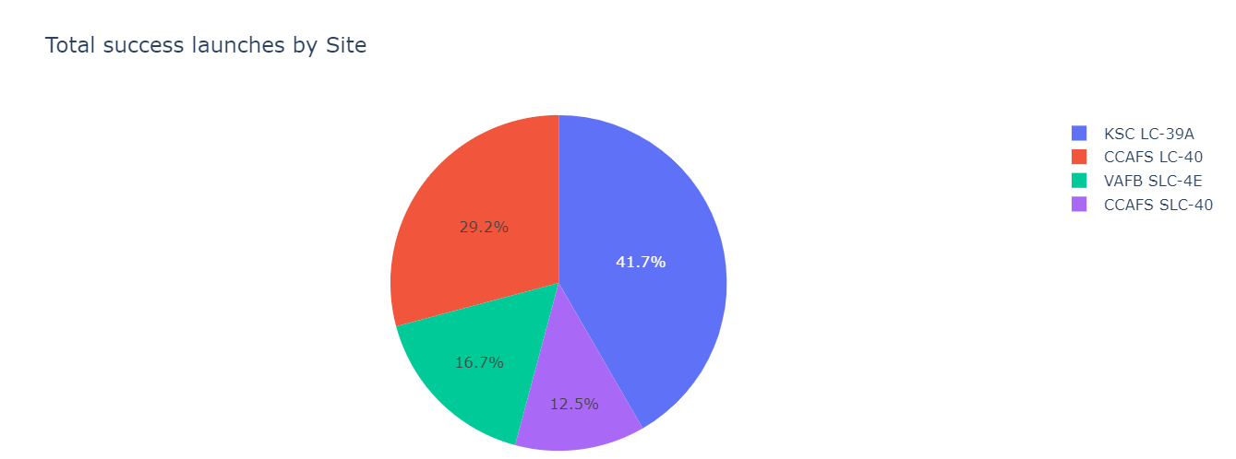
Pie chart showing success% of different sites
KSC LC-39A has the most number of successful launches compared to other launch sites

Slide 43
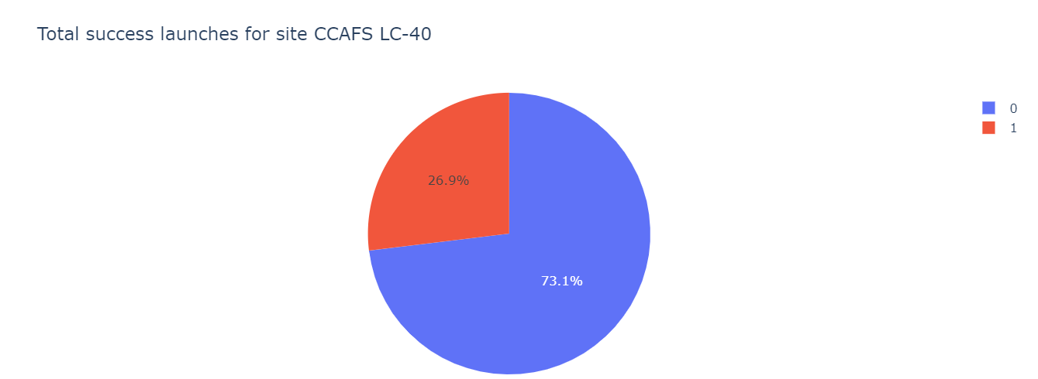
Pie chart showing the Launch site with the highest launch success ratio

Slide 44
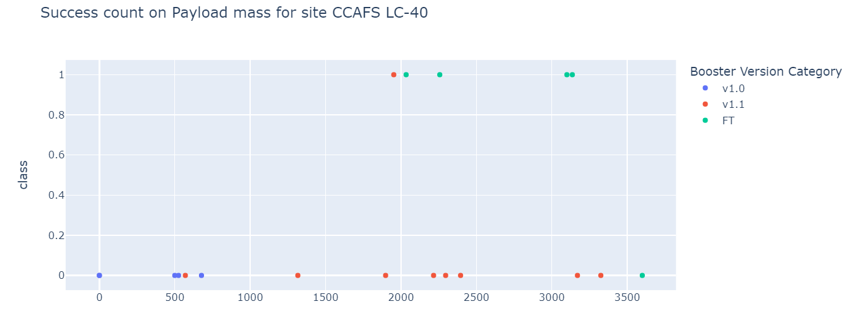
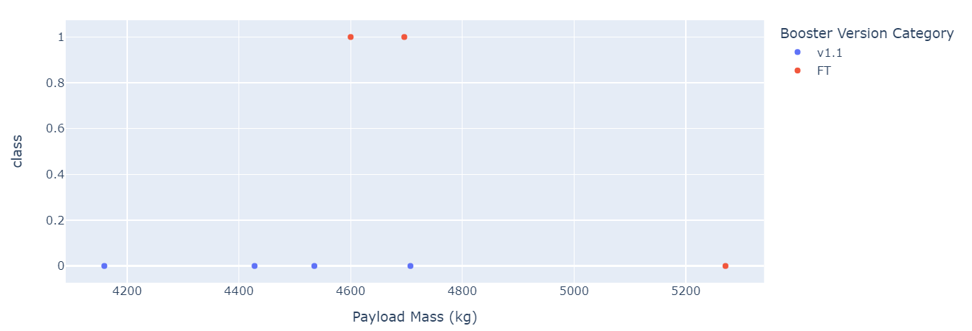
Scatter plot of Payload vs Launch Outcome for all sites, with different payload selected in the range slider

Slide 45

Section 5

Slide 46

Classification Accuracy

Slide 47

Confusion Matrix
•The confusion matrix for the decision tree classifier shows that the classifier can distinguish between the different classes. The major problem is the false positives .i.e., unsuccessful landing marked as successful landing by the classifier.

Slide 48
Conclusions
We can conclude that:
•The larger the flight amount at a launch site, the greater the success rate at a launch site.
•Launch success rate started to increase in 2013 till 2020.
•Orbits ES-L1, GEO, HEO, SSO, VLEO had the most success rate.
•KSC LC-39A had the most successful launches of any sites.
•The Decision tree classifier is the best machine learning algorithm for this task.

Slide 49


